Slide 1
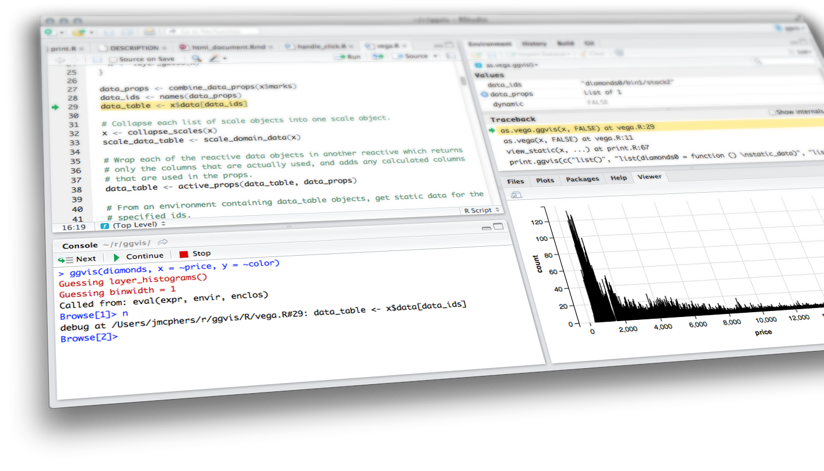

Course Overview
& Introduction to GitHub & Shiny
Shiny from

Slide 2
Course Overview
Instructor
Course Schedule
GitHub for Data Science
Read: Introduction to Github for Data Scientists by Rebecca Vickery
https://towardsdatascience.com/introduction-to-github-for-data-scientists-2cf8b9b25fba
R Projects
Shiny High level view
Anatomy of a Shiny app
User interface
Server function
Running the app
File Structure

Slide 3
Course
Overview

Slide 4
Geoffrey Arnold
geoffreylarnold @twitter
gla@andrew.cmu.edu

Slide 5
About me
Coordinator of Strategic Analytics
Allegheny County
MSPPM 2015
Heinz College

Slide 6
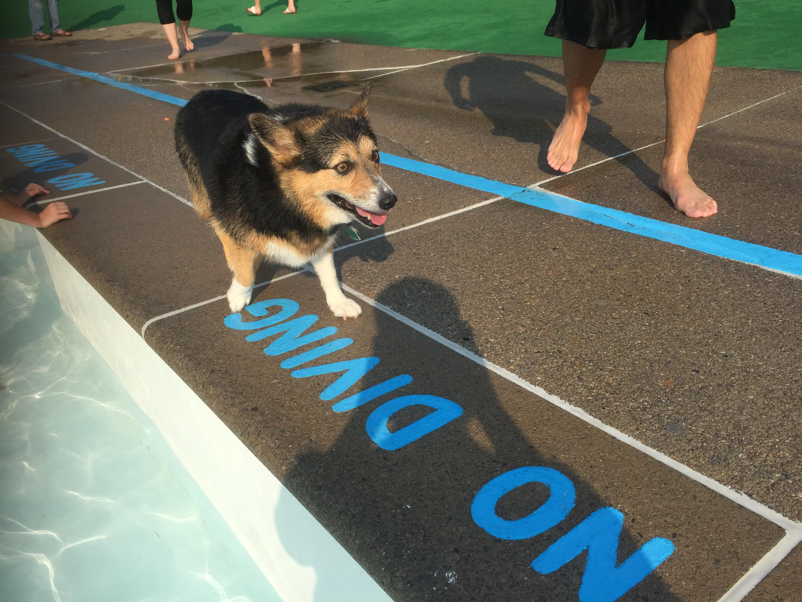
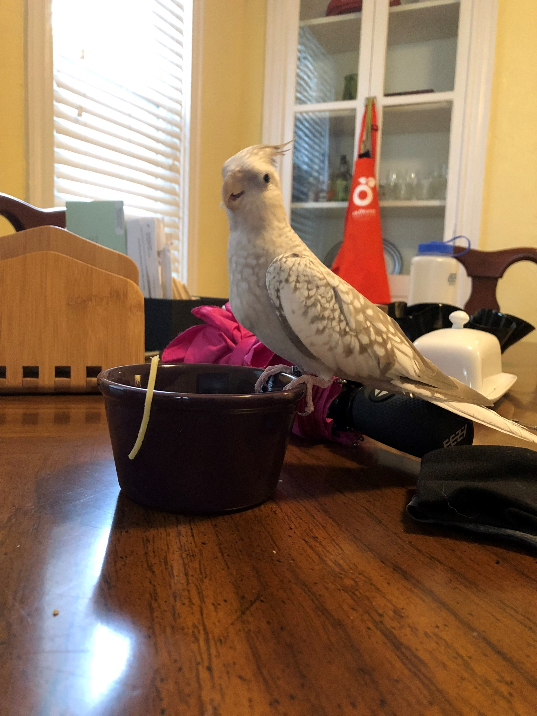

My Animals
Gracie
Winnifred
Louise

Slide 7
course Schedule
Class 1 - 2/4 - Course Overview & Introduction to GitHub & Shiny
Class 2 - 2/11 - Reactive Programming & User Interfaces
Class 3 - 2/18 - Reactive Programming Pt. 2 & Dashboards
Class 4 - 2/25 - Interactive Visualizations & Advanced Reactivity
Class 5 - 3/4 - Leaflet & LeafletProxy
Class 6 - 3/11 - Bookmarking & Final Project Work
Class 7 - 3/18 - Connecting to Databases & API's

Slide 8
Assignments
Homework 1: Create a basic ShinyApp
Homework 2: Create a Dashboard
Final Project: Create a ShinyApp with an Interactive Map

Slide 9
Office Hours
Zoom Poll
Offer Regular Zoom help sometime during the week
Offer a Course Slack Channel for “on-demand” help

Slide 10

Intro to Github

Slide 11
“Experience with version control is fast becoming a requirement for all data scientists”
–Rebecca Vickery

Slide 12
What is github?
Git is a Version Control Software
Github stores the files for your project in a remote location and checks the differences as you change your code
This allows you to roll back to previous versions of your project if you need to go back
Makes sharing and collaboration much easier using the Github website

Slide 13




Other version control
There are other kinds of version control software, GitLab also uses git.
We will be using Github in this course, but if in a future life, you might use these others.

Slide 14
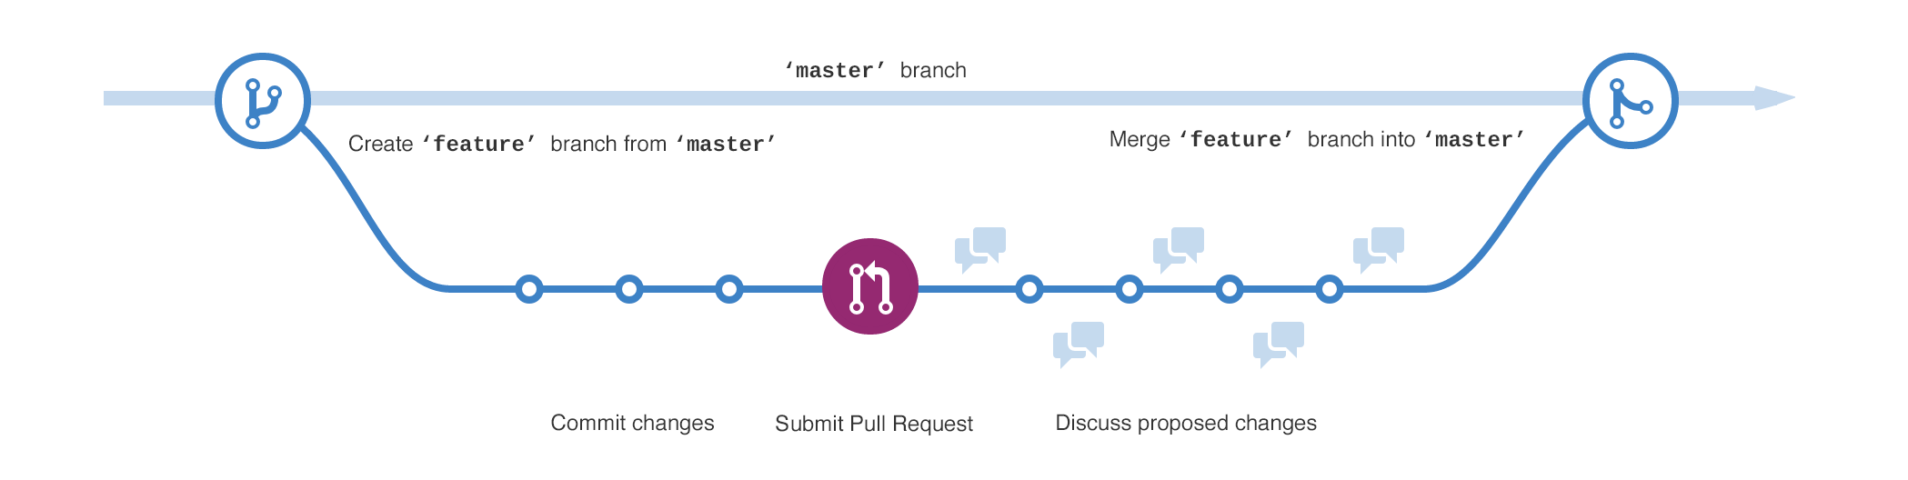

Slide 15
Github Desktop
and the Web

Slide 16

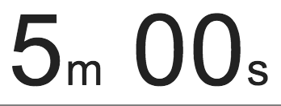
exercise
Download Github Desktop: https://desktop.github.com/
Sign up for Github: https://github.com/join
Got to course page: https://github.com/orgs/rforoperations2019/
Clone Class 2 repo: https://github.com/rforoperations2019/Class-02-Shiny-Intro
Create your own branch as your CMU username

Slide 17
Github and Projects in RStudio

Slide 18
“R Projects are great.”
–Geoffrey Arnold

Slide 19
R projects
So what is all this?
Avoid messy environment
Keep custom functions in check
Don’t lose your work just because you want to do something else
Info: https://support.rstudio.com/hc/en-us/articles/200526207-Using-Projects

Slide 20
How do projects work?
R typically saves your environment information in a default location (typically your Documents folder)
When you create a project it gets its own .RData file for the project in the Directory/folder you created
This is also the default working directory for your project, so no need to put all of the folders its in
Simply load objects by name if they’re in the project folder

Slide 21
exercise
Create a “New Project”
Select “New Directory”
Select "New Project”
Make sure the “Create a git repository” is selected
Give the project any name you want
Click “Create Project”
Look at the “Git” tab

Slide 22
exercise
Click “File”
Click “New File”
Select “Shiny Web App”
Give the application a name and click “Create”
Click the “Git” tab
What’s change?

Slide 23
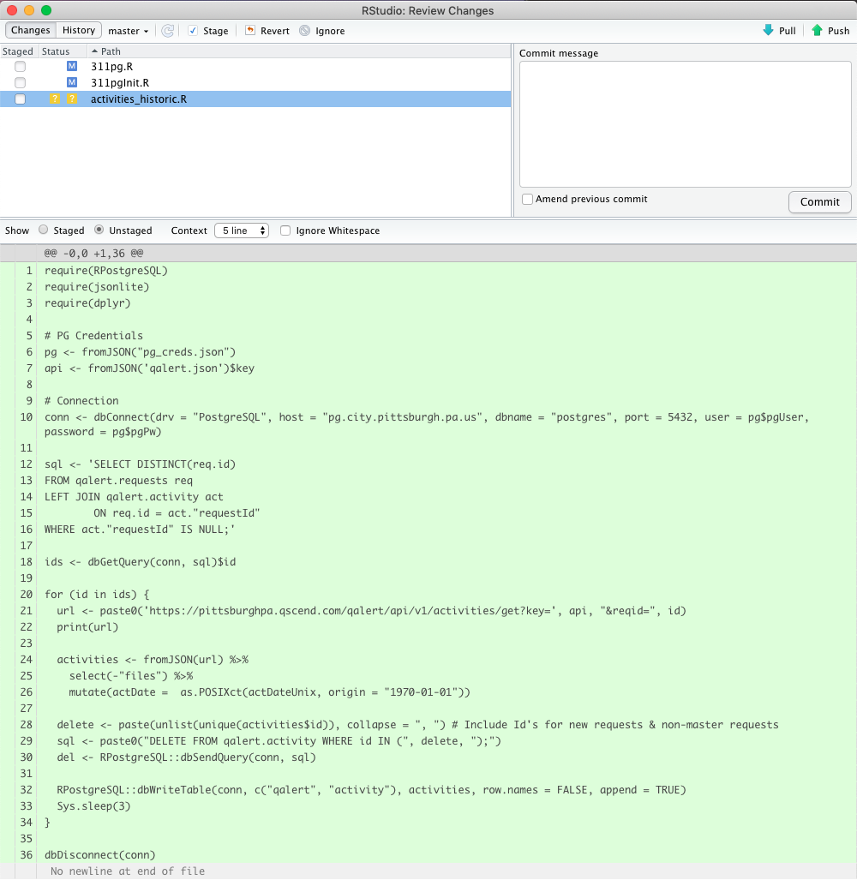
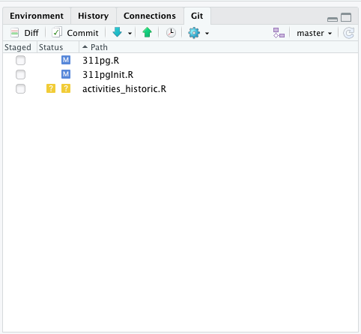
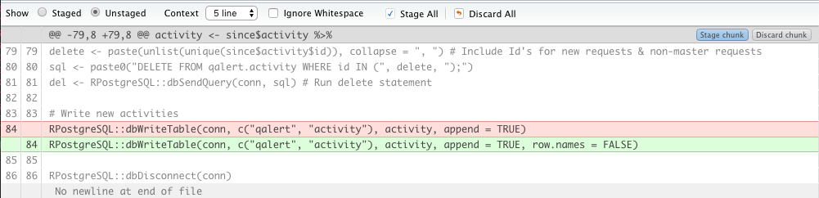

Slide 24
exercise
Go to “Global Options”
Click “Git/SVN”
Ensure “Enable version control interface for Studio projects” is selected
Click “Create RSA Key…”
Click “Create”
Click “View public key” and copy key
Go to https://github.com/settings/keys
Click “New SSH key”
Paste key in text box and give your key a name
Click “Add SSH Key”
If you have two factor authorization turned on for GitHub (people with previous GitHub accounts may have this turned on) you will need your Personal Access Token to login later
Everyone else, your GitHub login and password will be important when logging in later.

Slide 25
exercise
Click the “Git” tab
Click “Commit”
Type a message into the “Commit message” box
Stage the files by making sure they are selected on the left
Click “Commit”
Click “Push”
Login to GitHub with either your password or personal access token

Slide 26
Github in the command line / terminal

Slide 27
Whats the command line
Command or terminal git commands are how git was first used.
You don’t need to know how to do these things as either the “Git” tab in RStudio or the Github desktop program provides a GUI (gooey user interface) for you.
However, knowing the hard way to do something never hurt anybody.

Slide 28
exercise
https://learngitbranching.js.org/
Complete Introduction Sequences
Git Commits
Branching Git
Merging in Git

Slide 29
Shiny Examples
Burghs Eye View
Covid-19 Tracker
2019 Best Design Shiny Contest Winner
Covid-19 Daily Epidemic Forecasting
Port Authority Bus Tracker
Allegheny County House Price Estimator

Slide 30
Class Break
Shiny from

Slide 31
Shiny High level
view

Slide 32
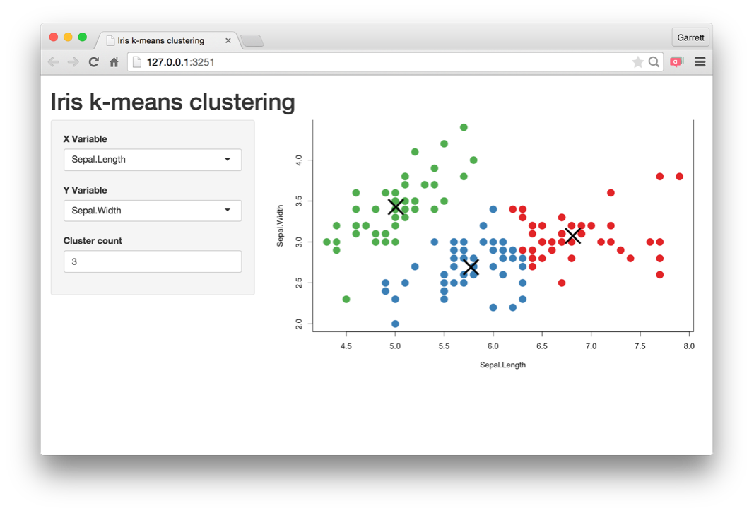
Every Shiny app is maintained by a computer running R
Shiny from

Slide 33
Every Shiny app is maintained by a computer running R
Shiny from

Slide 34
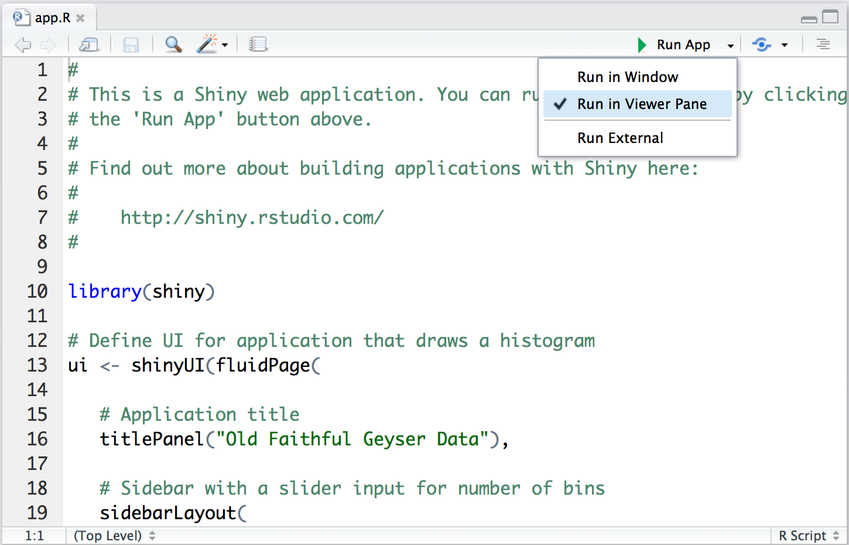

Change display
Shiny from

Slide 35
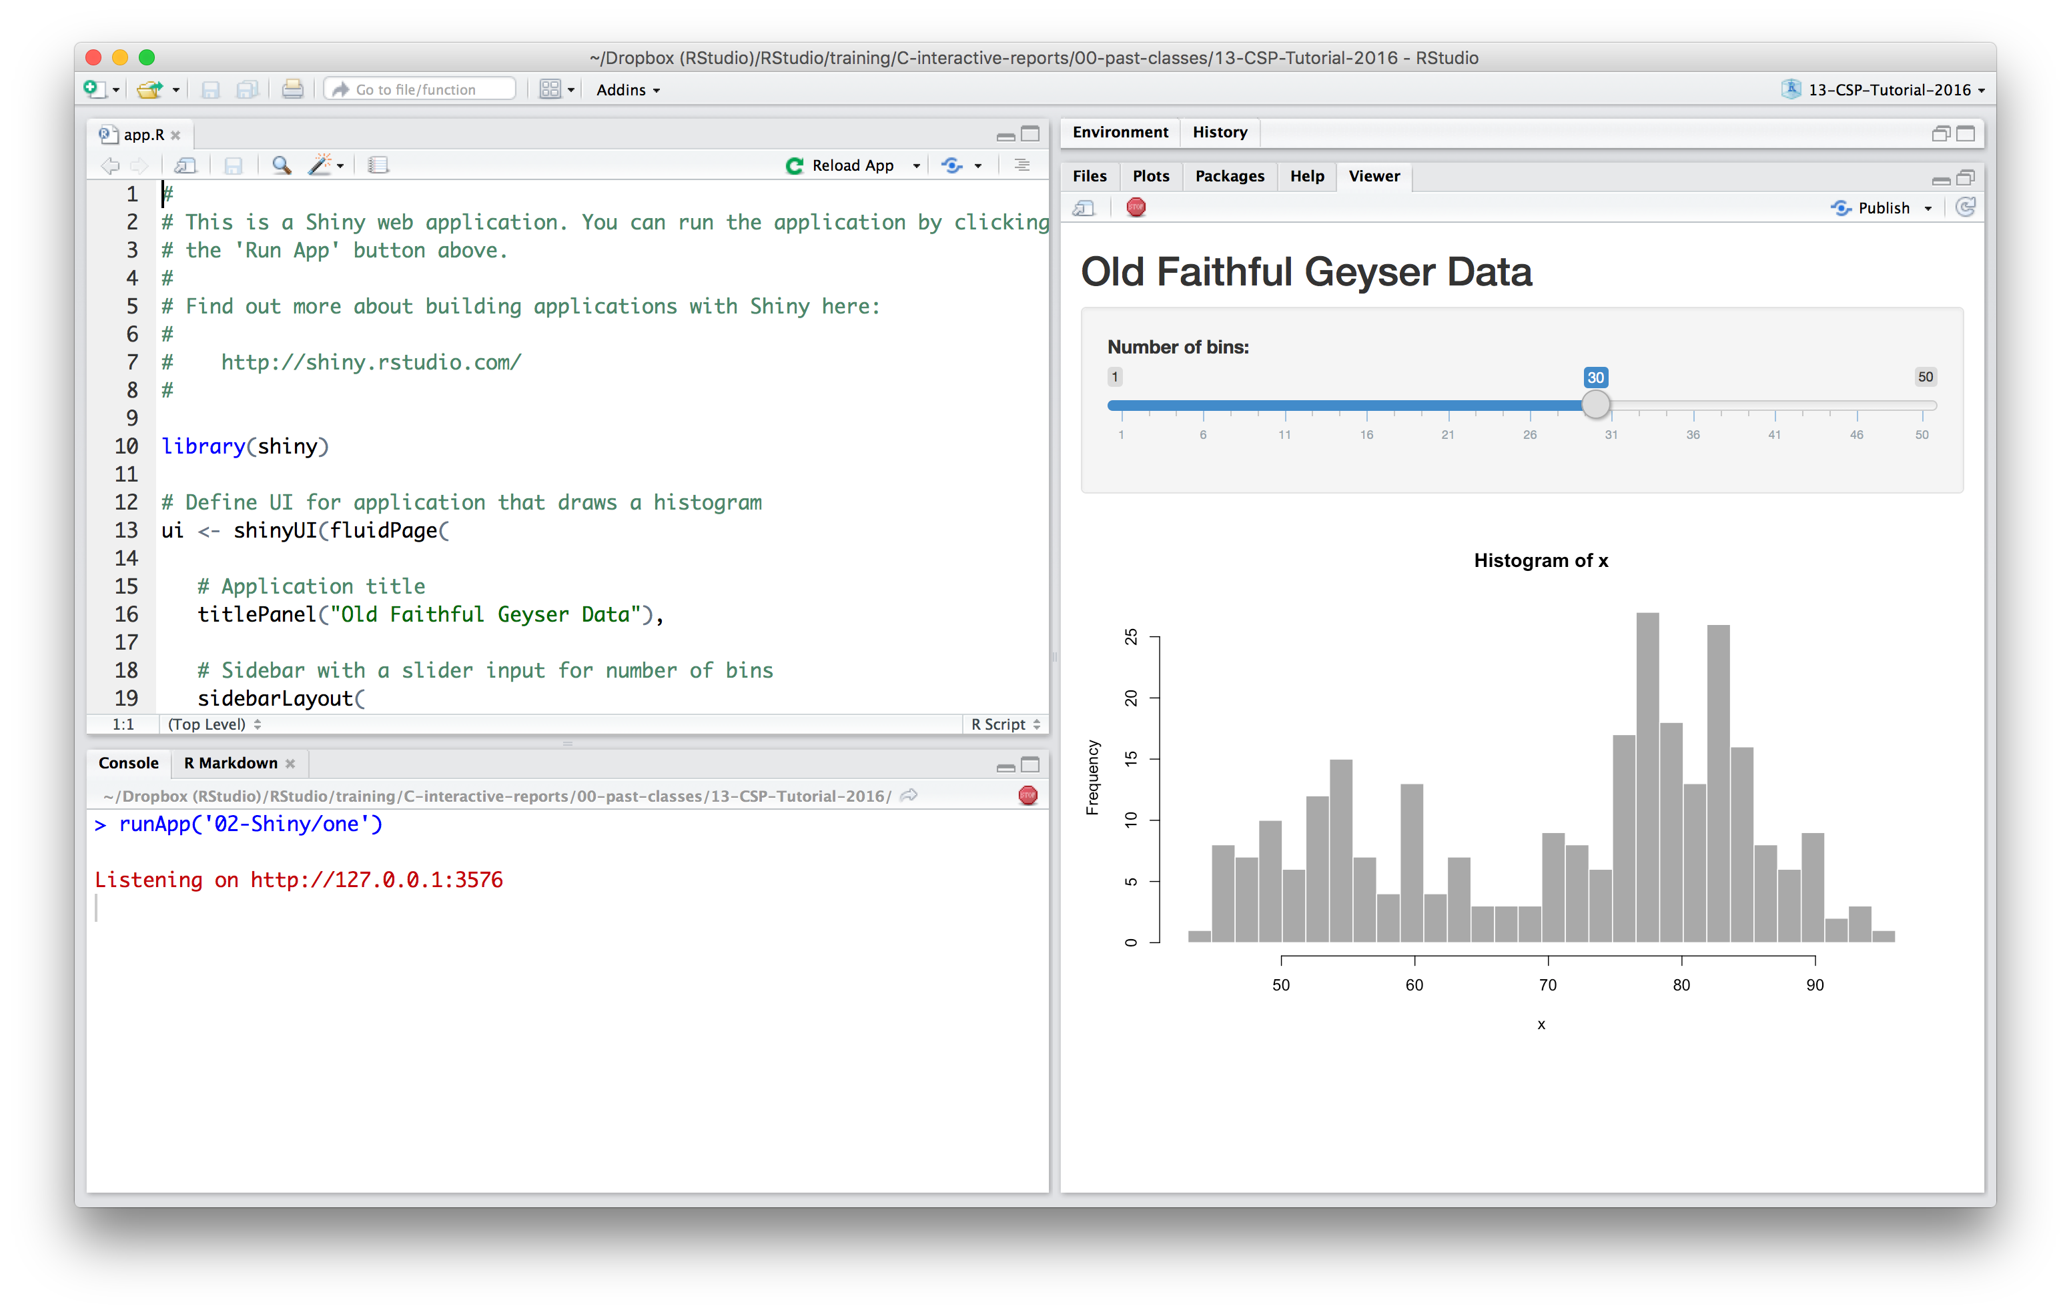
Close an app
Shiny from

Slide 36
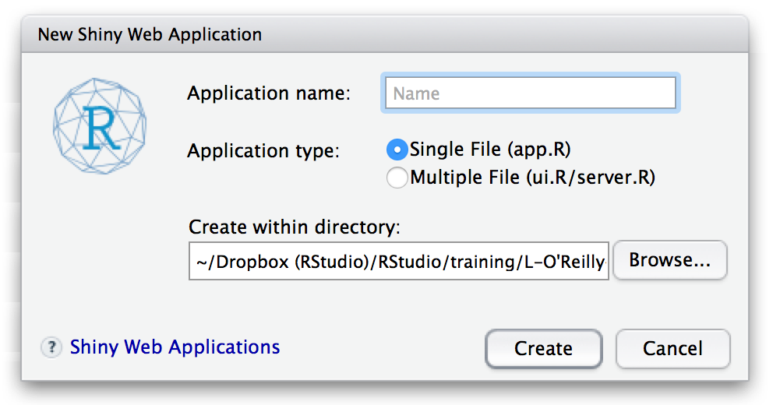
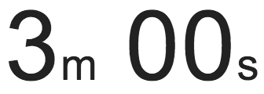
exercise
Open a new Shiny app with
File ▶︎ New File ▶︎ Shiny Web App…
Launch the app by opening app.R and
clicking Run App
Run App
Close app by clicking the stop sign icon
STOP
Select view mode in the drop down menu next to Run App
Shiny from
Notes:
3 minutes

Slide 37
Anatomy of
a Shiny app

Slide 38
what’s in an app?
library(shiny)
ui <- fluidPage()
server <- function(input, output) {}
shinyApp(ui = ui, server = server)
User interface
controls the layout and appearance of app
Server function
contains instructions
needed to build app

Slide 39
Let’s build a simple movie browser app!
movies.Rdata
Data from IMDB and Rotten Tomatoes on random sample of 651 movies released in the US between 1970 and 2014
Shiny from

Slide 40
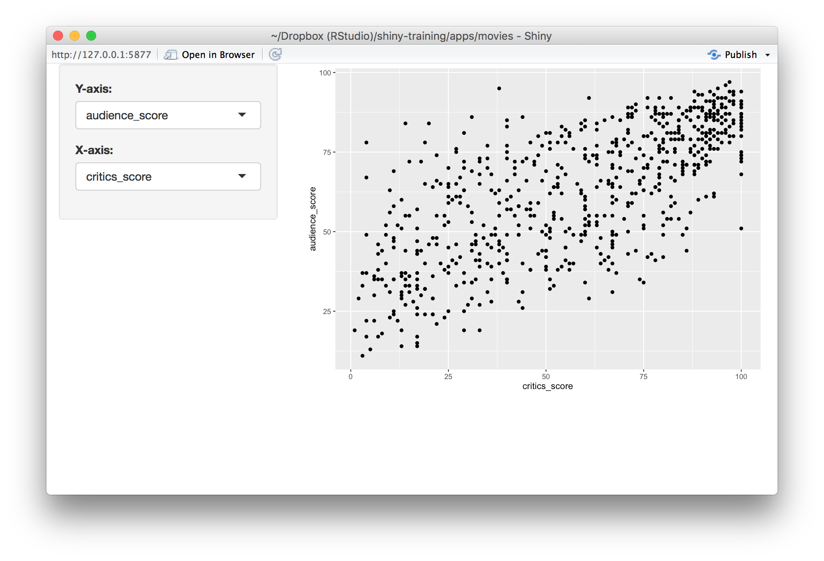
Shiny from

Slide 41
APP Template
library(shiny)
library(ggplot2)
load("movies.Rdata")
ui <- fluidPage()
server <- function(input, output) {}
shinyApp(ui = ui, server = server)
Dataset used for this app

Slide 42
User interface

Slide 43
# Define UI for application that plots features of movies
ui <- fluidPage(
# Sidebar layout with a input and output definitions
sidebarLayout(
# Inputs: Select variables to plot
sidebarPanel(
# Select variable for y-axis
selectInput(inputId = "y", label = "Y-axis:",
choices = c("imdb_rating", "imdb_num_votes", "critics_score", "audience_score", "runtime"),
selected = "audience_score"),
# Select variable for x-axis
selectInput(inputId = "x", label = "X-axis:",
choices = c("imdb_rating", "imdb_num_votes", "critics_score", "audience_score", "runtime"),
selected = "critics_score")
),
# Output: Show scatterplot
mainPanel(
plotOutput(outputId = "scatterplot")
)
)
)
Shiny from
Notes:
Quickly show the UI, say this is too much to parse at once, then skip to next slide with highlighting and go through components step by step

Slide 44
Create fluid page layout
# Define UI for application that plots features of movies
ui <- fluidPage(
# Sidebar layout with a input and output definitions
sidebarLayout(
# Inputs: Select variables to plot
sidebarPanel(
# Select variable for y-axis
selectInput(inputId = "y", label = "Y-axis:",
choices = c("imdb_rating", "imdb_num_votes", "critics_score", "audience_score", "runtime"),
selected = "audience_score"),
# Select variable for x-axis
selectInput(inputId = "x", label = "X-axis:",
choices = c("imdb_rating", "imdb_num_votes", "critics_score", "audience_score", "runtime"),
selected = "critics_score")
),
# Output: Show scatterplot
mainPanel(
plotOutput(outputId = "scatterplot")
)
)
)
Shiny from
Notes:
Discuss components, note that vertical lines are animated, starting on the outside moving in
Highlighting notes:
fluidPage: Tangerine
sidebarLayout: Magenta
sidebarPanel: Ocean
mainPanel: Fern

Slide 45
# Define UI for application that plots features of movies
ui <- fluidPage(
# Sidebar layout with a input and output definitions
sidebarLayout(
# Inputs: Select variables to plot
sidebarPanel(
# Select variable for y-axis
selectInput(inputId = "y", label = "Y-axis:",
choices = c("imdb_rating", "imdb_num_votes", "critics_score", "audience_score", "runtime"),
selected = "audience_score"),
# Select variable for x-axis
selectInput(inputId = "x", label = "X-axis:",
choices = c("imdb_rating", "imdb_num_votes", "critics_score", "audience_score", "runtime"),
selected = "critics_score")
),
# Output: Show scatterplot
mainPanel(
plotOutput(outputId = "scatterplot")
)
)
)
Create a layout with a
sidebar and main area
Shiny from
Notes:
Discuss components, note that vertical lines are animated, starting on the outside moving in
Highlighting notes:
fluidPage: Tangerine
sidebarLayout: Magenta
sidebarPanel: Ocean
mainPanel: Fern

Slide 46
# Define UI for application that plots features of movies
ui <- fluidPage(
# Sidebar layout with a input and output definitions
sidebarLayout(
# Inputs: Select variables to plot
sidebarPanel(
# Select variable for y-axis
selectInput(inputId = "y", label = "Y-axis:",
choices = c("imdb_rating", "imdb_num_votes", "critics_score", "audience_score", "runtime"),
selected = "audience_score"),
# Select variable for x-axis
selectInput(inputId = "x", label = "X-axis:",
choices = c("imdb_rating", "imdb_num_votes", "critics_score", "audience_score", "runtime"),
selected = "critics_score")
),
# Output: Show scatterplot
mainPanel(
plotOutput(outputId = "scatterplot")
)
)
)
Create a sidebar panel containing input controls that can in turn be passed to sidebarLayout
Shiny from
Notes:
Discuss components, note that vertical lines are animated, starting on the outside moving in
Highlighting notes:
fluidPage: Tangerine
sidebarLayout: Magenta
sidebarPanel: Ocean
mainPanel: Fern

Slide 47
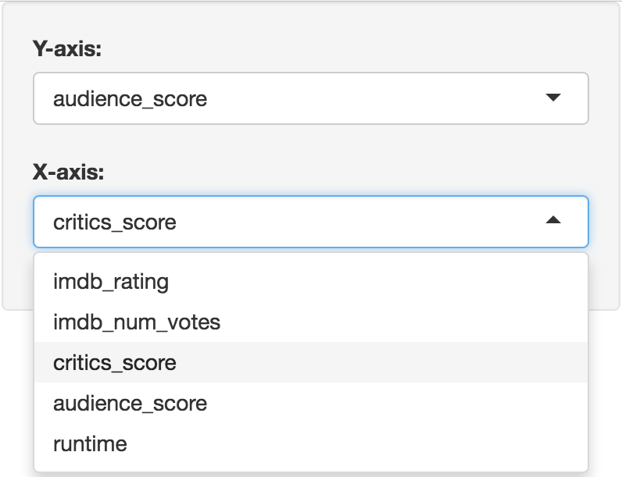
# Define UI for application that plots features of movies
ui <- fluidPage(
# Sidebar layout with a input and output definitions
sidebarLayout(
# Inputs: Select variables to plot
sidebarPanel(
# Select variable for y-axis
selectInput(inputId = "y", label = "Y-axis:",
choices = c("imdb_rating", "imdb_num_votes", "critics_score", "audience_score", "runtime"),
selected = "audience_score"),
# Select variable for x-axis
selectInput(inputId = "x", label = "X-axis:",
choices = c("imdb_rating", "imdb_num_votes", "critics_score", "audience_score", "runtime"),
selected = "critics_score")
),
# Output: Show scatterplot
mainPanel(
plotOutput(outputId = "scatterplot")
)
)
)
Shiny from
Notes:
Discuss components, note that vertical lines are animated, starting on the outside moving in
Highlighting notes:
fluidPage: Tangerine
sidebarLayout: Magenta
sidebarPanel: Ocean
mainPanel: Fern

Slide 48
# Define UI for application that plots features of movies
ui <- fluidPage(
# Sidebar layout with a input and output definitions
sidebarLayout(
# Inputs: Select variables to plot
sidebarPanel(
# Select variable for y-axis
selectInput(inputId = "y", label = "Y-axis:",
choices = c("imdb_rating", "imdb_num_votes", "critics_score", "audience_score", "runtime"),
selected = "audience_score"),
# Select variable for x-axis
selectInput(inputId = "x", label = "X-axis:",
choices = c("imdb_rating", "imdb_num_votes", "critics_score", "audience_score", "runtime"),
selected = "critics_score")
),
# Output: Show scatterplot
mainPanel(
plotOutput(outputId = "scatterplot")
)
)
)
Create a main panel containing output elements that get created in the server function can in turn be passed to sidebarLayout
Shiny from
Notes:
Discuss components, note that vertical lines are animated, starting on the outside moving in
Highlighting notes:
fluidPage: Tangerine
sidebarLayout: Magenta
sidebarPanel: Ocean
mainPanel: Fern

Slide 49
Server function

Slide 50
# Define server function required to create the scatterplot
server <- function(input, output) {
# Create the scatterplot object the plotOutput function is expecting
output$scatterplot <- renderPlot({
ggplot(data = movies, aes_string(x = input$x, y = input$y)) +
geom_point()
})
}
Shiny from
Notes:
Quickly show the server function, say this is again too much to parse at once, then skip to next slide with highlighting and go through components step by step

Slide 51
# Define server function required to create the scatterplot
server <- function(input, output) {
# Create the scatterplot object the plotOutput function is expecting
output$scatterplot <- renderPlot({
ggplot(data = movies, aes_string(x = input$x, y = input$y)) +
geom_point()
})
}
Contains instructions
needed to build app
Shiny from

Slide 52
# Define server function required to create the scatterplot
server <- function(input, output) {
# Create the scatterplot object the plotOutput function is expecting
output$scatterplot <- renderPlot({
ggplot(data = movies, aes_string(x = input$x, y = input$y)) +
geom_point()
})
}
Renders a reactive plot that is suitable for assigning to an output slot
Shiny from

Slide 53
# Define server function required to create the scatterplot
server <- function(input, output) {
# Create the scatterplot object the plotOutput function is expecting
output$scatterplot <- renderPlot({
ggplot(data = movies, aes_string(x = input$x, y = input$y)) +
geom_point()
})
}
Good ol’ ggplot2 code,
with inputs from UI
Shiny from

Slide 54
Running the app

Slide 55
# Run the application
shinyApp(ui = ui, server = server)
Shiny from

Slide 56
demo
Putting it all together…
movies_01.R
Shiny from
Notes:
Putting it all together…

Slide 57
exercise
Add new select menu to color the points by
inputId = "z"
label = "Color by:"
choices = c("title_type", "genre", “mpaa_rating”, "critics_rating", "audience_rating")
selected = "mpaa_rating"
Use this variable in the aesthetics of the ggplot function as the color argument to color the points by
Run the app in the Viewer Pane
Compare your code / output with the person sitting next to / nearby you
Shiny from

Slide 58
Solution
Solution to the previous exercise
movies_02.R
Shiny from

Slide 59
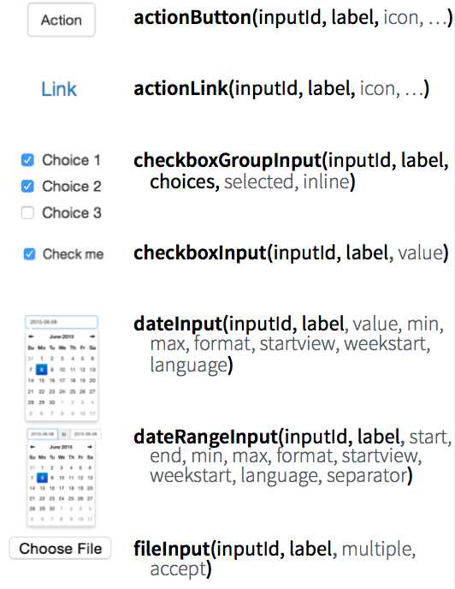
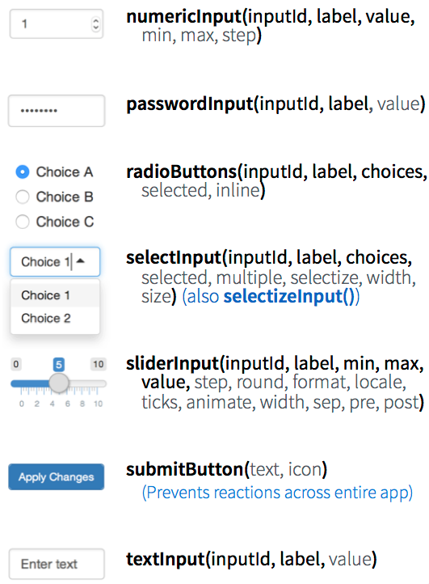
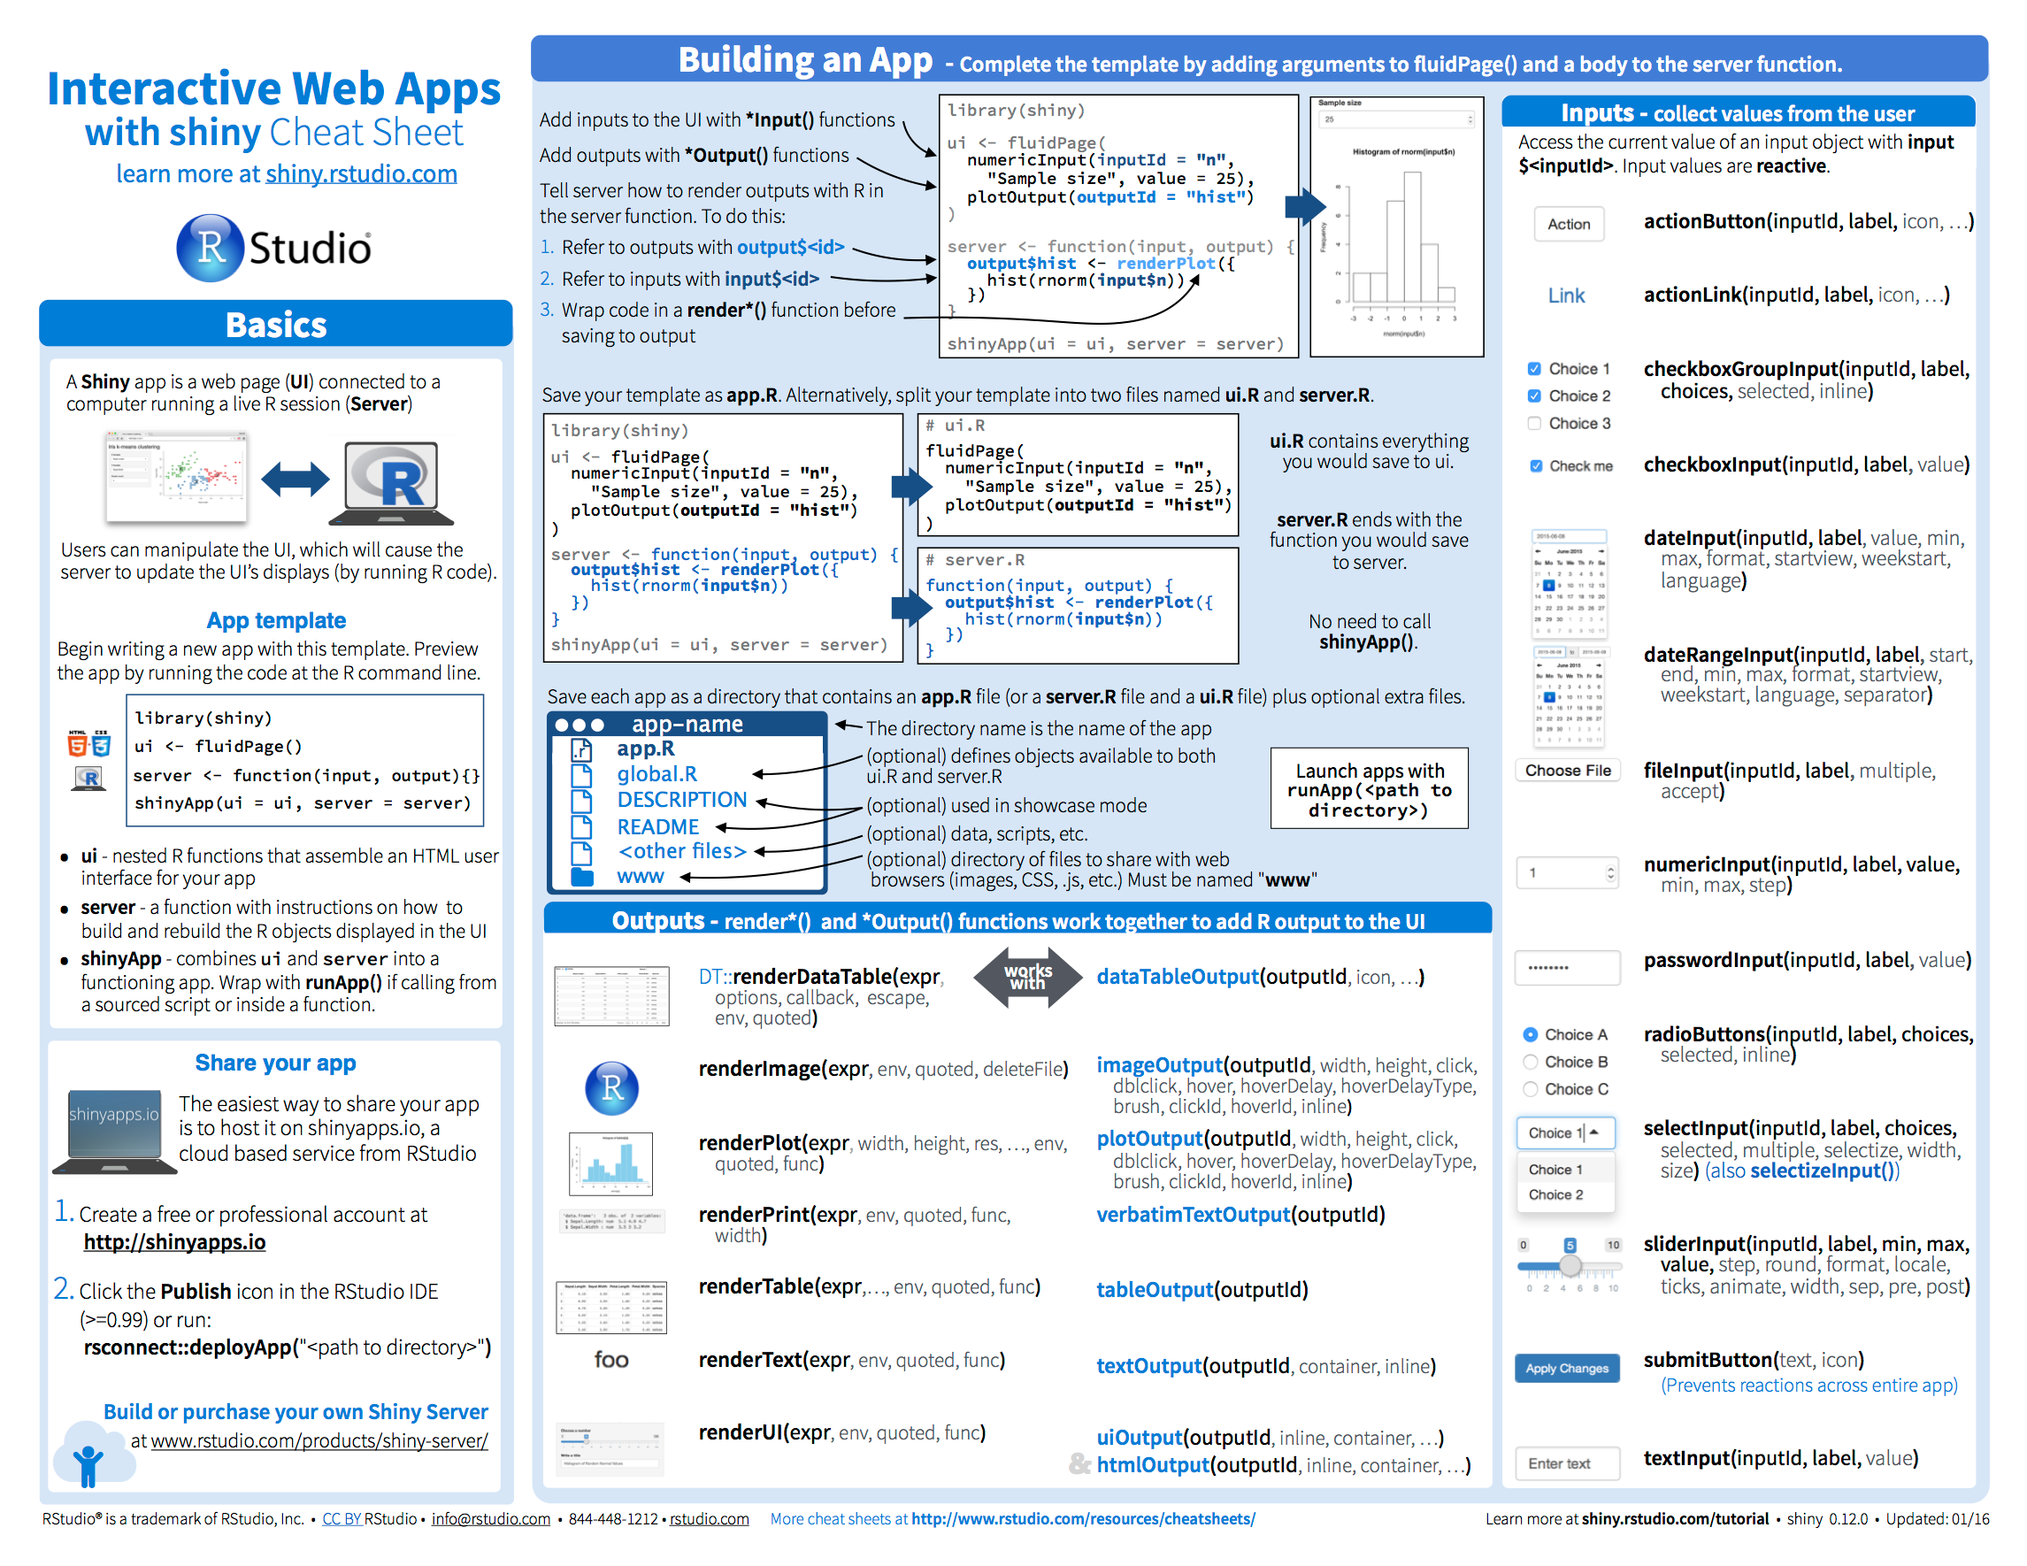
Inputs
https://www.rstudio.com/resources/cheatsheets/

Slide 60
exercise
Add new input variable to control the alpha level of the points
This should be a sliderInput
See shiny.rstudio.com/reference/shiny/latest/ for help
Values should range from 0 to 1
Set a default value that looks good
Use this variable in the geom of the ggplot function as the alpha argument
Run the app in a new window
Compare your code / output with the person sitting next to / nearby you
Shiny from

Slide 61
Solution
Solution to the previous exercise
movies_03.R
Shiny from

Slide 62
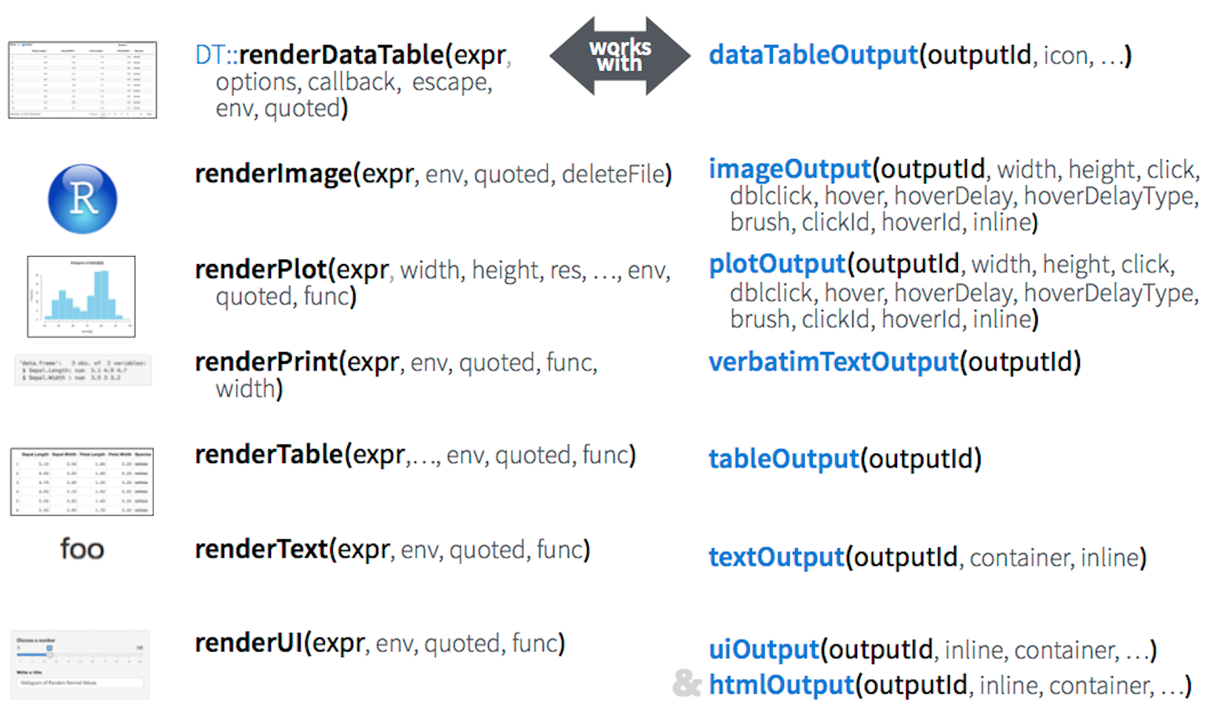
Outputs

Slide 63
exercise
Add a checkbox input to decide whether the data plotted should be shown in a data table
This should be a checkboxInput (see shiny.rstudio.com/reference/shiny/latest/ for help)
Create a new output item using DT::renderDataTable, an if statement to check if the box is checked, and DT::datatable
Show first seven columns of movies data, show 10 rows at a time, and hide row names, e.g.
data = movies[, 1:7]
options = list(pageLength = 10)
rownames = FALSE
Add a dataTableOutput to the main panel
Run the app in a new Window, check and uncheck the box to test functionality
Compare your code / output with the person sitting next to / nearby you
Optional: If you finish early, move on to the next exercise
Shiny from

Slide 64
Solution
Solution to the previous exercise
movies_04.R
Shiny from

Slide 65
exercise
Optional: If you finish the previous exercise early
Add a title to your app with titlePanel, which goes before the sidebarLayout
Prettify the variable names shown as input choices. Hint:
choices = c("IMDB rating" = "imdb_rating", …)
Prettify the axis and legend labels of your plot. Hint: You might use
str_replace_all from the stringr package
toTitleCase from the tools package
Shiny from

Slide 66
Solution
Solution to the previous exercise
movies_05.R
Shiny from

Slide 67
File structure

Slide 68
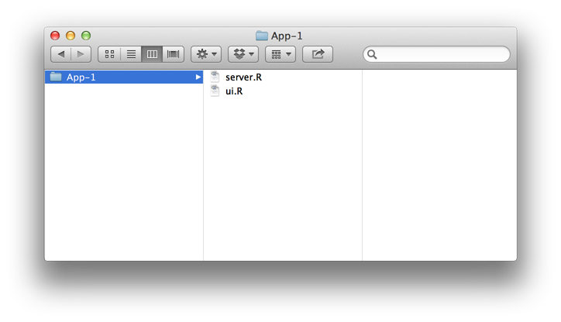
saving your single file app
One directory with every file the app needs:
app.R (your script which ends with a call to shinyApp())
datasets, images, css, helper scripts, etc.
app.R
We will focus on the single file format throughout the workshop
You must use this
exact name (app.R)
for deploying the app

Slide 69
saving your multiple file app
One directory with every file the app needs:
ui.R and server.R
datasets, images, css, helper scripts, etc.
You must use these
exact names

Slide 70
Sharing
your app

Slide 71

shinyapps.io
by

Slide 72
shinyapps.io
A server maintained by RStudio
easy to use
secure
scalable
Notes:
easy to use: Deploying your Shiny applications could not be easier. You don’t need to own a server or know how to configure a firewall to deploy and manage your applications in the cloud. No hardware, installation, or annual purchase contract required.
secure: shinyapps.io is secure-by-design. Each Shiny application runs in its own protected environment and access is always SSL encrypted. Standard and Professional plans offer user authentication, preventing anonymous visitors from being able to access your applications.
scalable: We bring our IT team so you won’t have to bring yours. Be confident your compute resources will scale effortlessly as your Shiny applications and users increase.

Slide 73
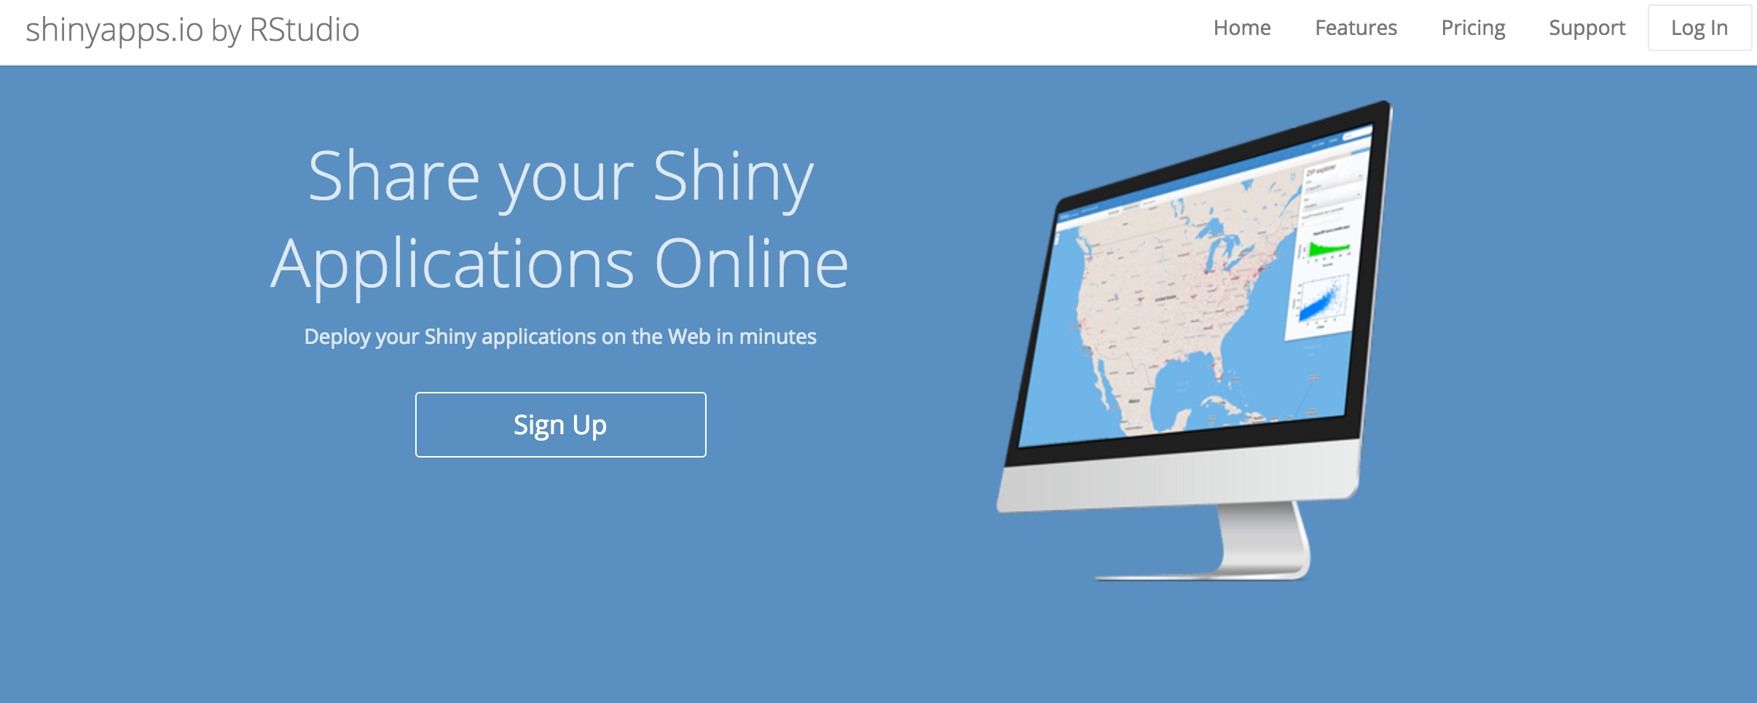
hassle-free cloud hosting for shiny

Slide 74
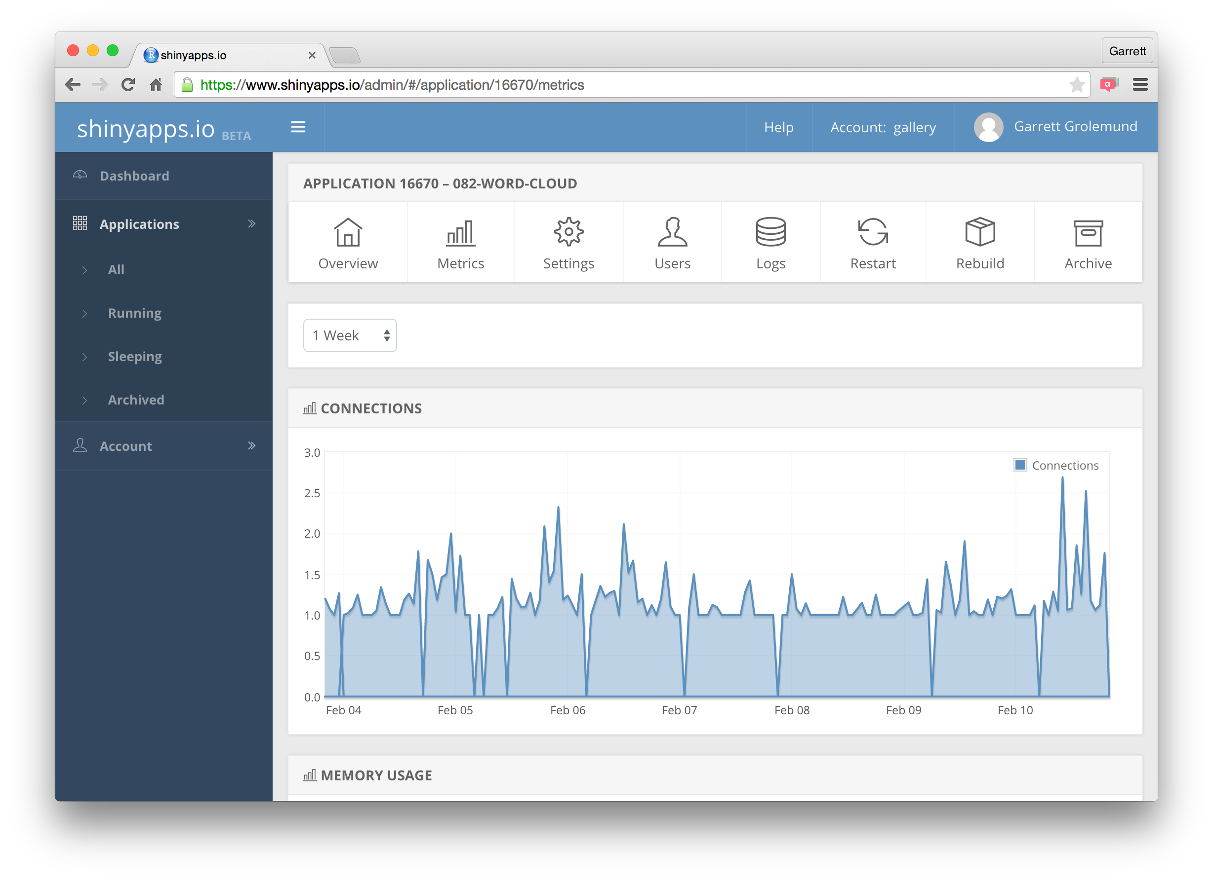
with built-in metrics

Slide 75
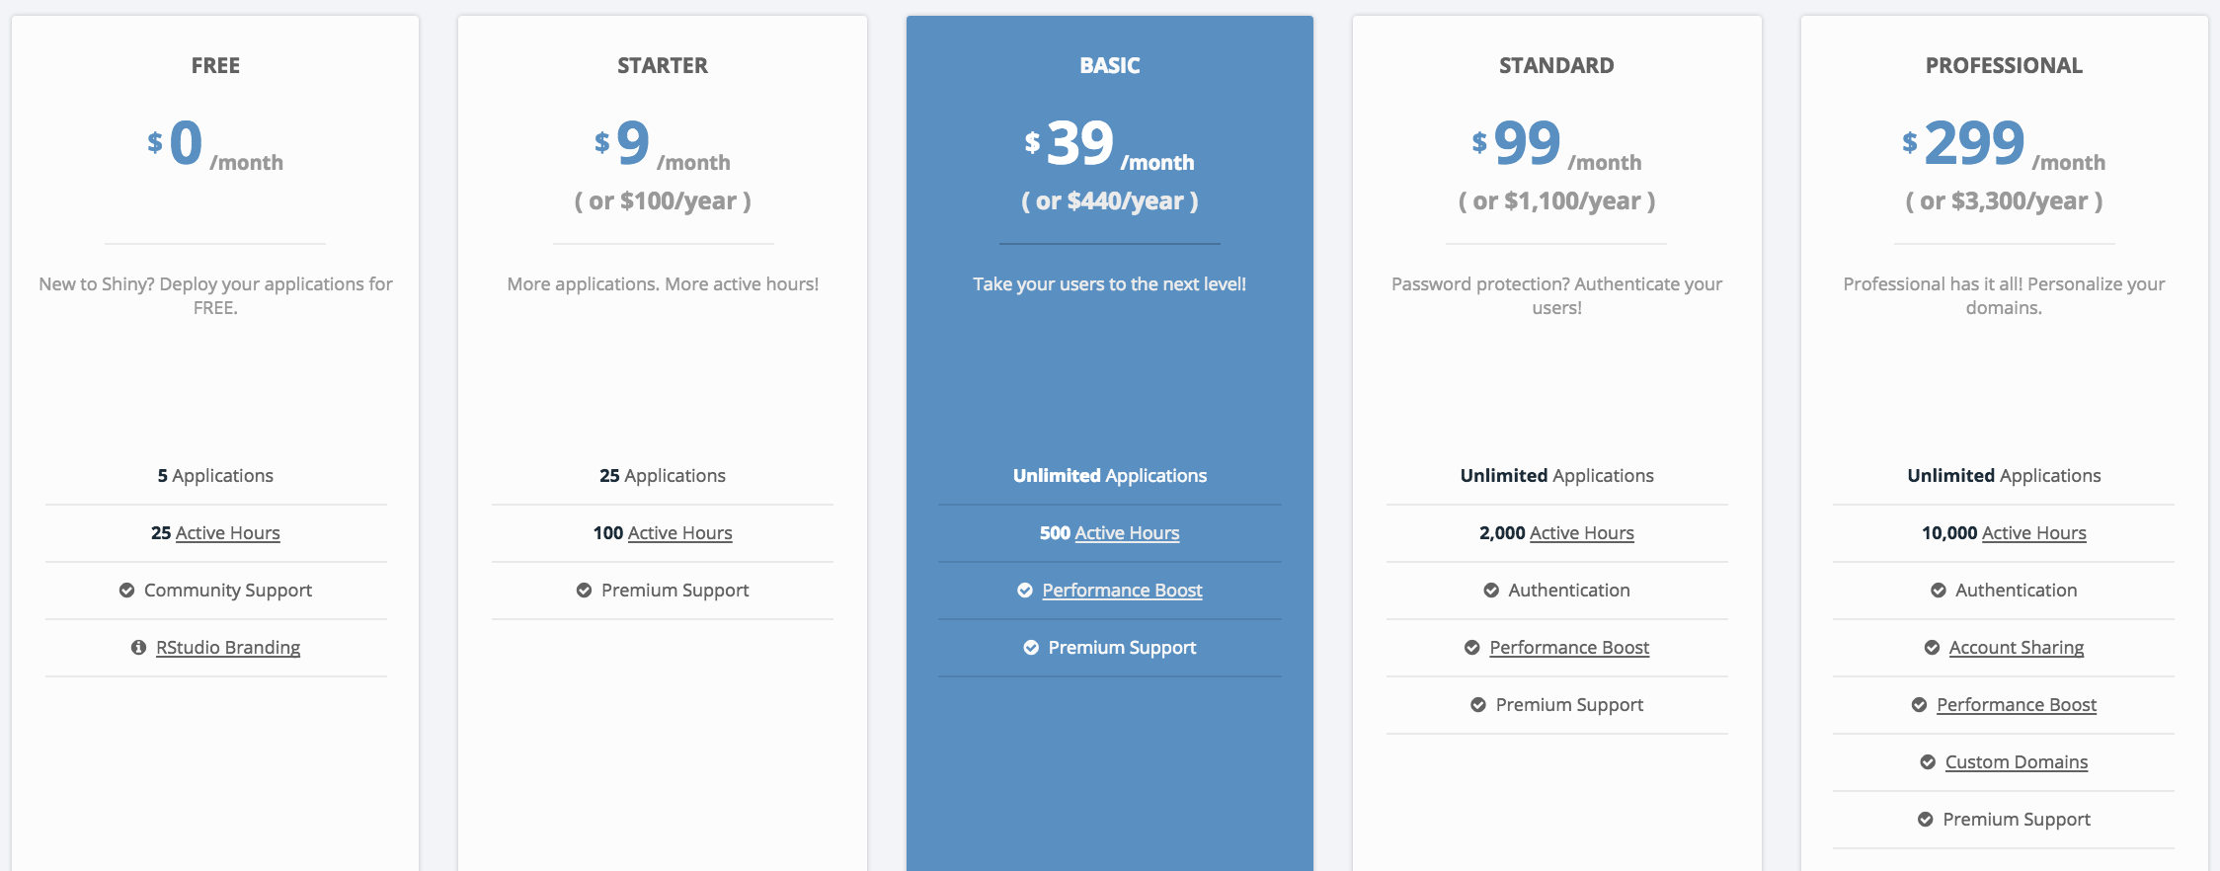
membership pricing

Slide 76
Build your own server

Slide 77
Shiny Server
rstudio.com/products/shiny/shiny-server/
Deploy Shiny apps to the internet
Run on-premises
move computation closer to the data
Host multiple apps on one server
Deploy inside the firewall
xcopy deployment
Free & open source

Slide 78
Shiny Server pro
rstudio.com/products/shiny/shiny-server/
Secure access
LDAP, GoogleAuth, SSL, and more
Performance
fine tune at app and server level
Management
monitor and control resource use
Support
direct priority support
45 day evaluation free trial

Slide 79









What does a typical setup with SSP look like?
Shiny Server Pro
Production
Data Scientists
RStudio IDE
End Users
Web Browsers
Sticky Load Balancer
Staging
Data Stores
File Share
Data Mart

Slide 80

How do I deploy apps?
Local Disk
FTP / SCP / SFTP
RStudio IDE
Shiny Server
Shared Disk
save / copy

Slide 81




How do I deploy apps in production?
Version Control
Handoff
Analyst
IT
Stage
Production
Push to version control and
automate clones via a scheduler
Analyst stage app
IT deploys to production

Slide 82
More information
Sharing your apps tutorial: https://shiny.rstudio.com/tutorial/written-tutorial/lesson7/
Administering Shiny Server Pro webinar: https://www.rstudio.com/resources/webinars/administering-shiny-server-pro/

Slide 83
exercise
Create a folder called movies in the ShinyApps folder
Move any one of the movies app R scripts you worked on into this folder, and rename it as app.R
Also move the movies.Rdata file into this folder
Run the app
Then go to http://harpers-ferry.rstudio.com:3838/[username]/movies to view and interact with the deployed app
Shiny from
© 2016 RStudio, Inc. All rights reserved.

Slide 84
RStudio Connect
rstudio.com/products/connect/
Push-button publish from RStudio
Shiny apps, R Markdown docs, and more
Self-managed content
content authors decide permissions
Scheduled reports
automatically run and email Rmd
Support
direct priority support
45 day evaluation free trial

Slide 85
ShinyProxy
shinyproxy.io/
Secure access
LDAP, GoogleAuth, SSL, and more
Management
View open apps and generate usage statistics
Docker
uses docker to maintain dedicated app instances
Open Source
ACL’s
AD groups can restrict app access
Free & open source!

Slide 86
More information
Shinyproxy documentation: https://www.shinyproxy.io/deploying-apps/
Shinyproxy github repo: https://github.com/openanalytics/shinyproxy

Slide 87
How do I deploy apps?
RStudio IDE
shinyproxy
Build a Docker Image

Slide 88
Course Overview
& Introduction to GitHub & Shiny
Shiny from

